Slide 1
DESIGN AND DEVELOPMENT
OF
HEARTBEAT MEASURING DEVICE
BY
MUBINUN AWAISU
6217000141

Slide 2
Abstract
In this project we presented the design and development of device for measuring heart rate using fingertip to improve estimating the heart rate. As heart related diseases are increasing day by day, the need for an accurate heart rate measuring device or heart monitor is essential to ensure quality of health.

Slide 3
AIM
To design and construct a heartbeat measuring device.
To design a graphical user interface to display the result.

Slide 4
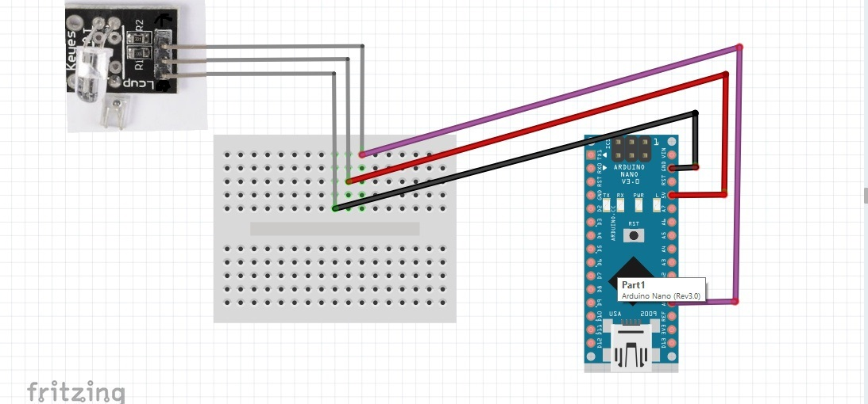
The Complete Circuit Diagram

Slide 5
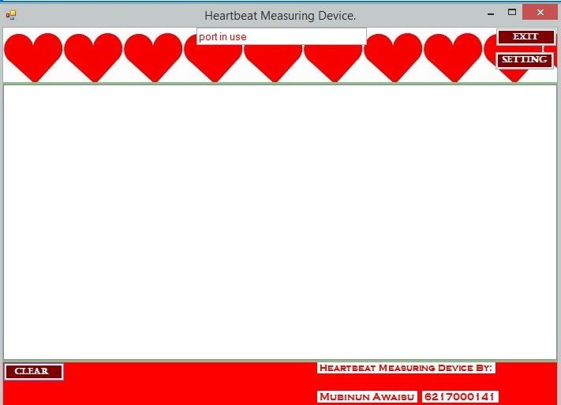
DISPLAY UNIT
GUI used to display the Output.
It was connected using serial port.

Slide 6
Mode Of Operation
Step 1: Place your finger on the sensor.
Step 2: wait for some seconds.
Step 3: Is the sensor find a pulse or frequency of a beating heart?
Step 4: If yes; display the heart beat per minute on the GUI.
Step 5: If No; then an invalid result will be displayed.
Sep 6: Repeat step 1 to step 5.

Slide 7
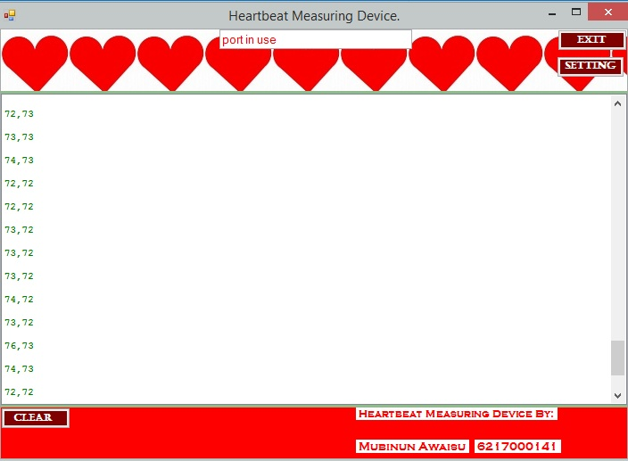
RESULT OBTAIN

Slide 8
CONCLUSION
Heartbeat measuring device was designed and constructed using Arduino.
Arduino and the heartbeat sensor are hardware while GUI is the software.
Together they obtain the beat of the heart.
Hence, the aim of the project has been achieved.

Slide 9
THANK YOU FOR LISTENING

